Slide 1

Basic Details of the Team and Problem Statement
Ministry/Organization Name/Student Innovation:
Ministry of Skill Development and Entrepreneurship (MSDE)
PS Code: DB875
Problem Statement Title: One-Stop Platform for budding entrepreneurs for Overall Support
Team Name: DEV_404
Team Leader Name: Prem Kumar
Institute Code: U-0953
Institute Name: Indian Institute of Information Technology,
Bhagalpur
Theme Name: Smart Education

Slide 2
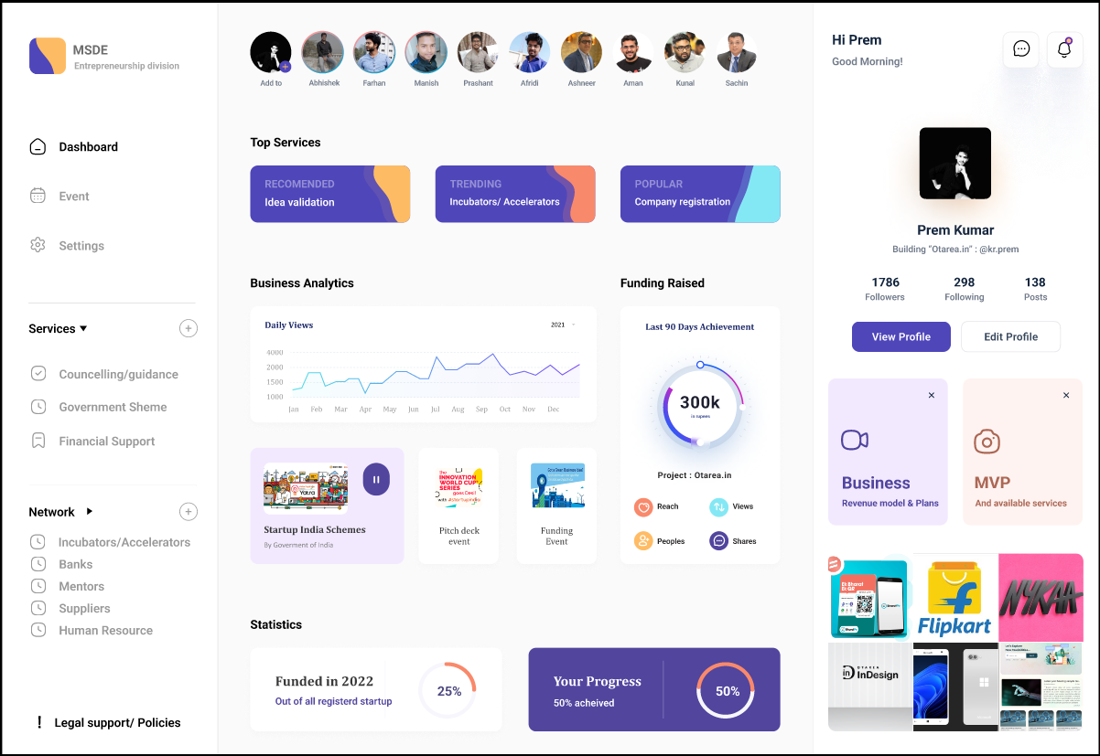
Idea/Approach Details
Describe your idea/Solution/Prototype here:
The single window platform for guiding aspiring entrepreneurs i.e. under the entrepreneurship division of MSDE.“
Helping entrepreneurs in idea nurturing
Connecting entrepreneurs with incubators
extending mentoring and handholding support
creating financial and marketing linkages
complying with legal and statutory compliances for starting business.
Linkage with various Government sponsored schemes for finance, loans
Describe your Technology stack here:
Cross Platform app and web tech
(Flutter, Dart, React, Android studio, Visual Studio)
Backend: Firebase
(along with aws)
Database: MongoDB
Host: Microsoft Azure
Open Source, API, and other technology

Slide 3
Idea/Approach Details
Describe your Use Cases here
Describe your Dependencies / Show stopper here
For connect with industry mentors ideally who run businesses, for project or Start-up related discussions. Connect to interested private sector (individuals, organization) willing to provide funding support as well as invest in these enterprises.
For registration of the company, For Legal and Statutory Compliances for ease of starting business
For mentoring and handholding of new enterprises in Tier I & II as well as villages in India.
Financial linkages with various Govt. Sponsored Schemes, Linkage with Investor/ Funding Agencies /Banks
For connect with Suppliers, Linkage with Required Human Resources
Policy guidance, Making vocal the local products (advertisement guideline guidance) (p)
Connect with pool of skilled laborers for the production/ service generation for the business
Mentors
Networking
Designing solutions
Database services
Hosting service
API, and other

Slide 4
Team Member Details
Team Leader Name: Prem Kumar
Branch (Btech/Mtech/PhD etc): Btech Stream (ECE, CSE etc): CSE Year (I,II,III,IV): II
Team Member 1 Name: Abhishek Jha
Branch (Btech/Mtech/PhD etc): Btech Stream (ECE, CSE etc): ECE Year (I,II,III,IV): II
Team Member 2 Name: Ayushi Singh
Branch (Btech/Mtech/PhD etc): Btech Stream (ECE, CSE etc): CSE Year (I,II,III,IV): I
Team Member 3 Name: Farhan Raza
Branch (Btech/Mtech/PhD etc): Btech Stream (ECE, CSE etc): ECE Year (I,II,III,IV): II
Team Member 4 Name: Prashant Chouhan
Branch (Btech/Mtech/PhD etc): Btech Stream (ECE, CSE etc): ECE Year (I,II,III,IV): II
Team Member 5 Name: Asad Faridi
Branch (Btech/Mtech/PhD etc): Btech Stream (ECE, CSE etc): CSE Year (I,II,III,IV): II
Team Mentor 1 Name: Dr. Rupam Bhattacharya
Category (Academic/Industry): IIIT Bhagalpur Expertise (AI/ML/Blockchain etc): Domain Experience (in years): CSE
Team Mentor 2 Name: N/A
Category (Academic/Industry): Expertise (AI/ML/Blockchain etc): Domain Experience (in years):

